Slide 1

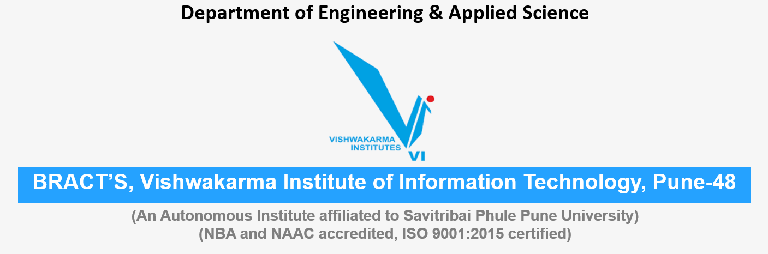
Water pollution Nashik city Energy , Water , Environment Sustainability
Roll No. | PRN | Name of student | Div. | VIIT email ID
1405 | 22110075 | Yash Gavit | N | yash.22110075@viit.ac.in
1412 | 22110206 | Prasad Nathe | N | prasad.22110206@viit.ac.in
1418 | 22110305 | Sahil Savardekar | N | sahil.22110350@viit.ac.in
1421 | 22110398 | Siddhesh Khairnar | N | siddhesh.22110398@viit.ac.in

Slide 2
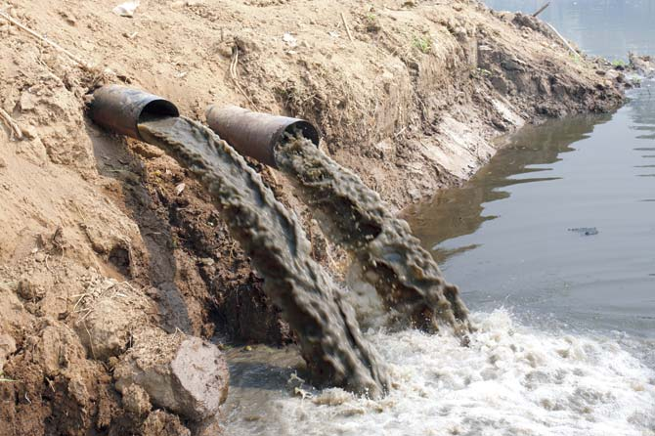
WHAT IS WATER POLLUTION ?
Water pollution is the release of substances into bodies of water that makes water unsafe for human use and disrupts aquatic ecosystems. Water pollution can be caused by a plethora of different contaminants, including toxic waste, petroleum, and disease-causing microorganisms.
Water pollutants come from either point sources or dispersed sources. A point source is a pipe or channel, such as those used for discharge from an industrial facility or a city sewerage system. A dispersed source is a very broad unconfined area from which a variety of pollutants enter the water body, such as the runoff from an agricultural area.

Slide 3
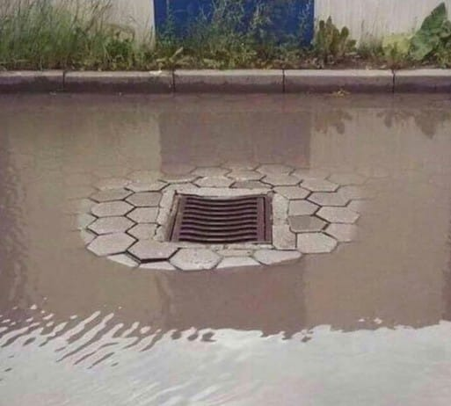
CAUSE OF WATER POLLUTION IN NASHIK
The farmers use pesticides, fungicides, fertilizers directly on the farm that contaminate water and cause atmospheric deposition. The runoff from the farms is the main reason why water bodies are polluted.
Common industrial pollutants responsible for causing water pollution are Sulphur, asbestos, noxious solvents, polychlorinated biphenyls, lead, mercury, nitrates, phosphates, acids, alkali, dyes, pesticides, benzene, chlorobenzene, carbon tetrachloride, toluene and volatile organic chemicals such as Sulphur are harmful.
Urbanization: water scarcity is created due to the overuse of water by the huge population.
Garbage islands are created when the wastes are dumped in the seas and oceans. Some of the main sources of marine pollution are oil spills from tankers, offshore drilling, and mining, industrial wastes, municipal waste, and sewages, dumping of radioactive waste, submarine nuclear testing.

Slide 4
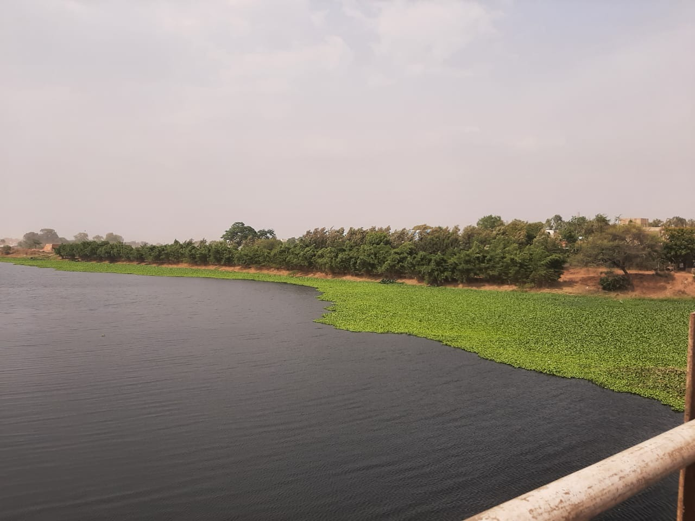
EFFECT OF WATER POLLUTION IN NASHIK
The unsafe use of non-conventional sources of water – especially wastewater – in agriculture can lead to the accumulation of microbiological and chemical pollutants in crops, livestock products and soil and water resources and ultimately to severe health impacts among exposed food consumers and farm workers.
Factories sometimes turn waterways into open sewers by dumping oil, toxic chemicals and other harmful liquids called effluents into them. These chemicals not only pollute the water reservoirs but also disturb the natural purification cycle of water carried out by microorganisms

Slide 5
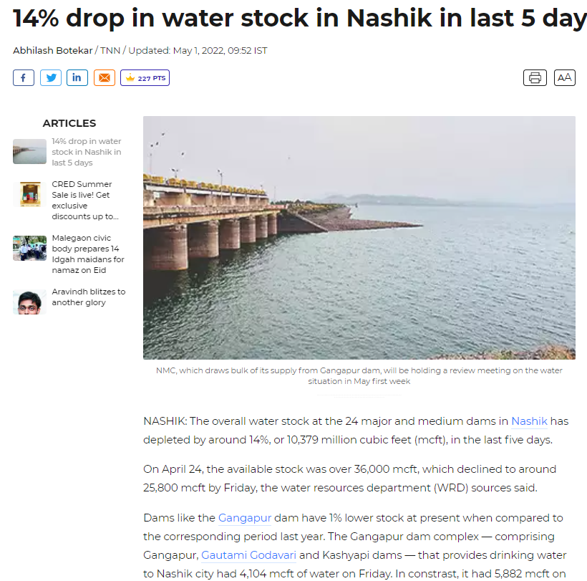
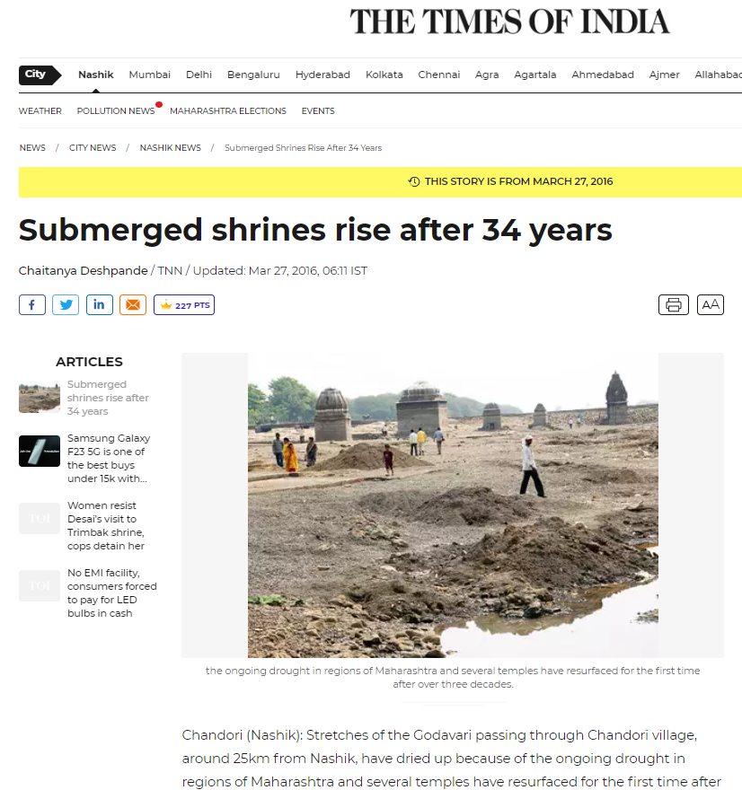

Slide 6
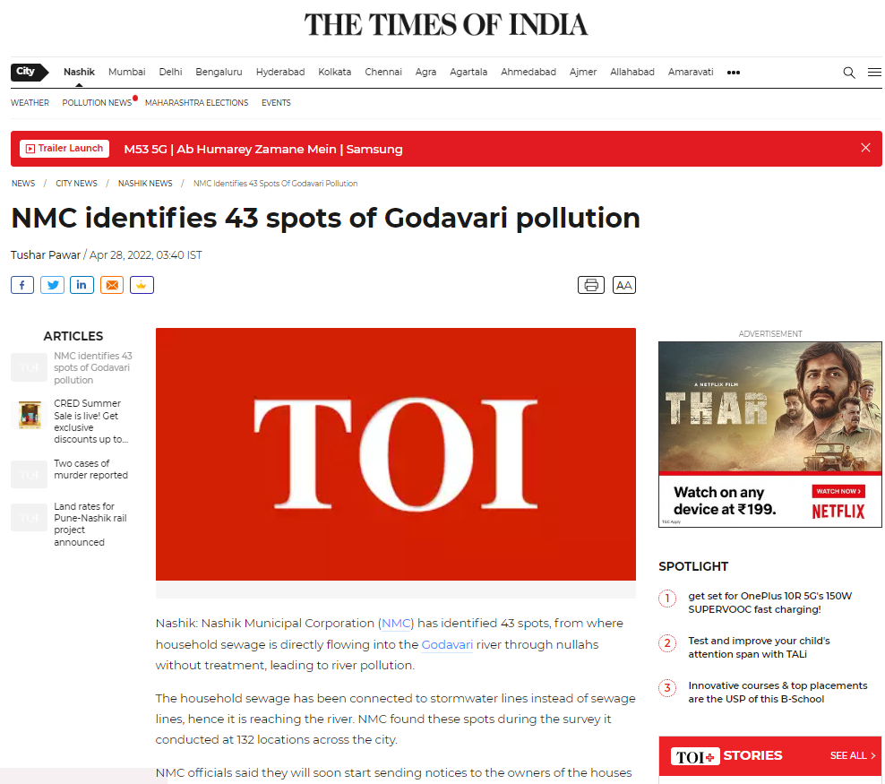

Slide 7
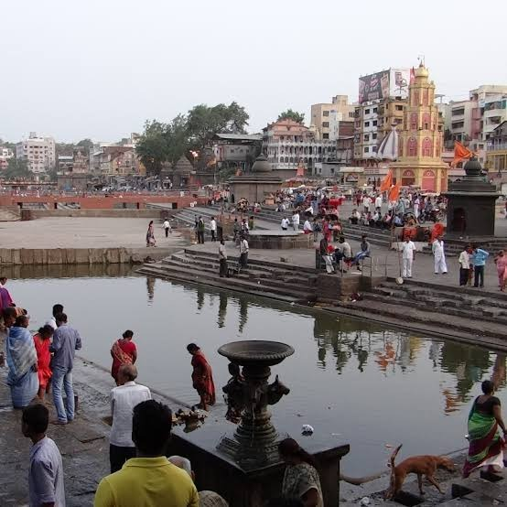
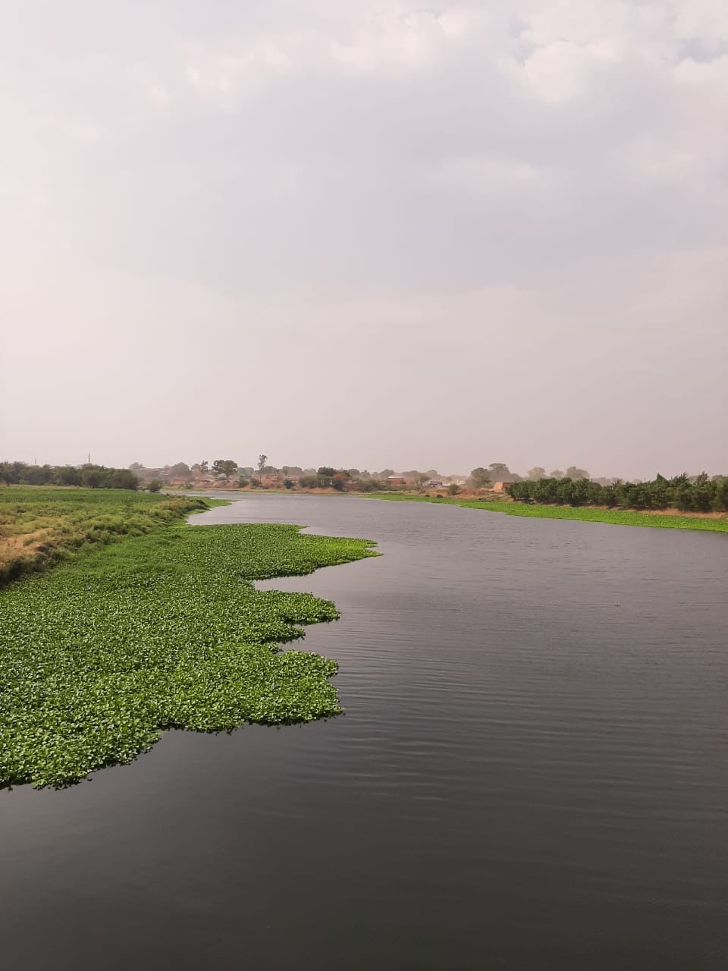
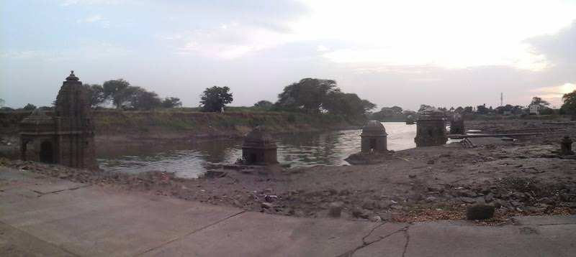
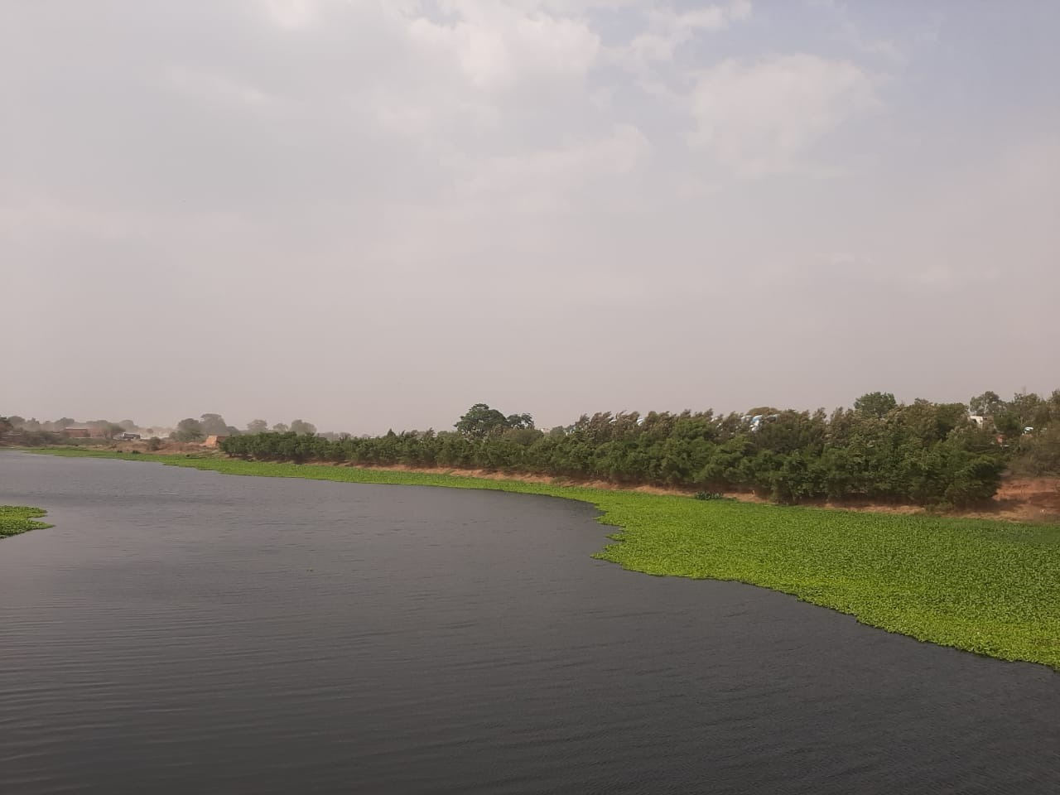
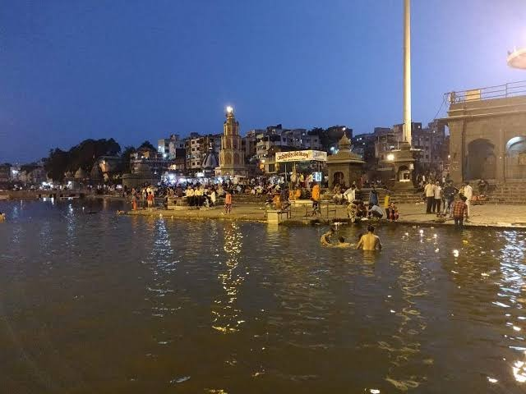

Slide 8
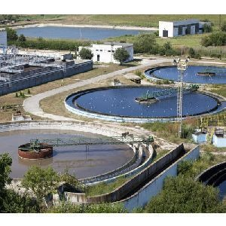
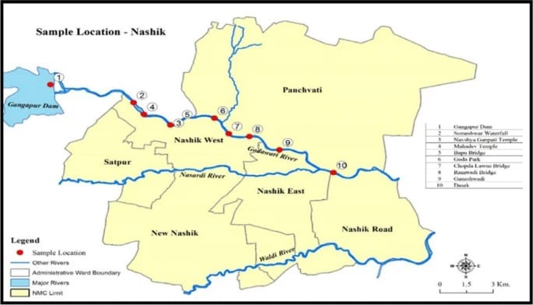
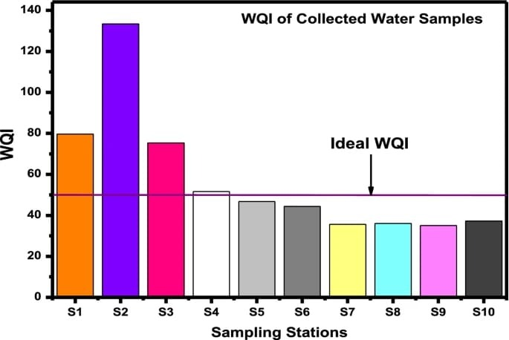
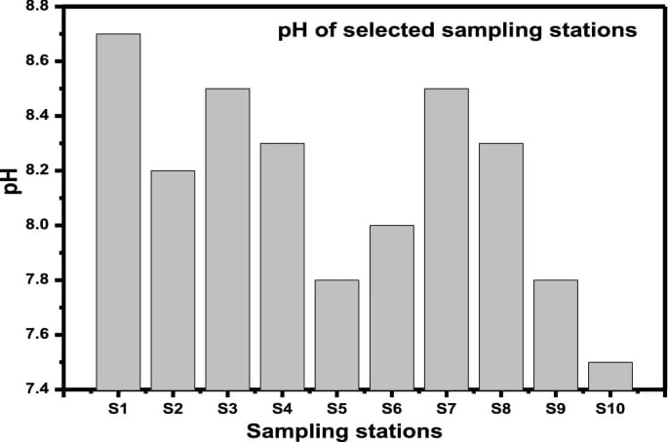
WATER TREAMENT PLANT:

Slide 9
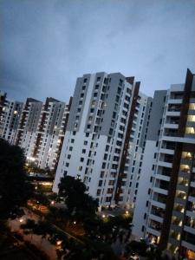
PROJECT TO REDUCE WATER POLLUTION:
To live a healthy life, it is necessary to use only clean water. But the fact is potable water i.e. drinking water is not available everywhere on the earth. Every year a large number of people die because of drinking contaminated water. There are many society where there is not enough drinking water.
So, there are some society which start small water treatment plant in it campus. Where they recycle the drainage water .

Slide 10

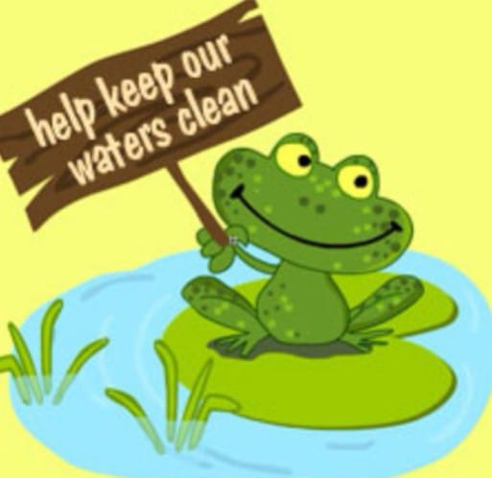
Measures To Control Water Pollution:
More trees should be planted. Plants such as water hyacinth absorb Cardium and mercury which are regarded as toxic substances of water bodies.
Wastes should be disposed of properly after proper waste treatment.
One should use natural pesticides and fertilizers in place of chemical fertilizers.
The level of water pollution can be checked by chemical processes such as ion exchange method, coagulation, reverse osmosis, etc.
An outcome of the paper industry which includes oil zapper, microorganisms, and sawdust is known as bregoli which is essential to remove oil spills in water.
Eucalyptus trees absorb the excess wastewater and give out pure water vapor in the atmosphere which is why more eucalyptus trees should be planted along with water bodies.
Use Less Plastic. It is very difficult to break down plastic after it is produced. Much of the plastic we consume ends up in the world’s water supply, where it is even harder to fish out and safely throw away.

Slide 11
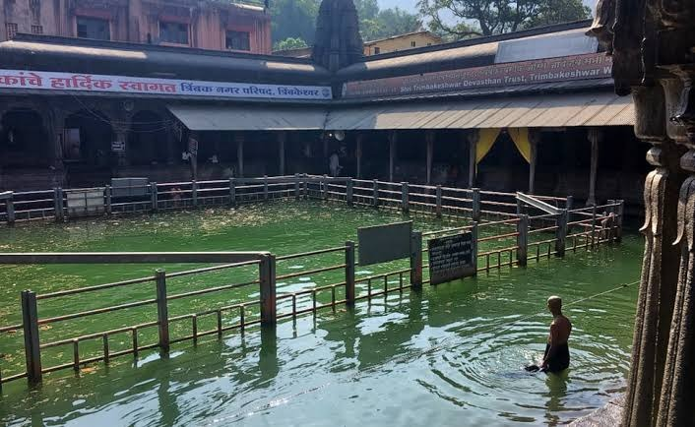
Wrap up and related outcomes
Wastewater treatment is a sustainable short and long-term solution to the world’s water crisis
Via today’s presentation , we tried to shed light on the ever growing problem of waste water and also discussed the remedies to tackle the problem at hand .
With the help of some Indian wastewater management systems we took a look at the industrial wastewater management procedures .
Taking the help of brilliant case studies , research papers and books regarding the topic at hand , we saw the scholarly approach and solutions for the problem.
By discussing the profound solutions for the problem , we can paint an optimistic picture for the future of wastewater management machinery .
At the end , we strive to continuously improve and achieve a seemingly impossible goal of pure water in every household and natural environment.

Slide 12
REFERENCES
https://timesofindia.indiatimes.com/city/nashik/14-drop-in-water-stock-in-nashik-in-last-5-days/articleshow/91222928.cms
https://timesofindia.indiatimes.com/city/nashik/nmc-to-lift-4-mld-more-water-from-gangapur-mukne-dams/articleshow/91328696.cms
https://timesofindia.indiatimes.com/city/nashik/submerged-shrines-rise-after-34-years/articleshow/51568200.cms
https://timesofindia.indiatimes.com/city/nashik/on-water-shortage-officials-told-to-identify-hard-to-reach-areas/articleshow/90767844.cms
https://timesofindia.indiatimes.com/city/nashik/nmc-identifies-43-spots-of-godavari-pollution/articleshow/91136225.cms

Slide 13

THANK YOU
Water is the source of life to keep it alive fight day and night.

